Slide 1

Bioinformatics Bootcamp
Special Topic Workshop: “Single Cell RNA-Seq Analysis”
Module 2: Single cell data preparation

Slide 2
scRNA-Seq Upstream Processing

Slide 3
scRNA-Seq Downstream Analysis Workflow
Load Data
QC
Normalize & Scale
PCA & Nearest Neighbor Graph
Clustering
Advanced:
Cluster Marker Analysis
Cell Type Identification
Sub-clustering
Trajectories
Cell Cycle Analysis
Cluster DGE
Low Dimensional Embedding

Slide 4
scRNA-Seq Downstream Analysis Workflow
Load Data
QC
Normalize & Scale
PCA & Nearest Neighbor Graph
Clustering
Advanced:
Cluster Marker Analysis
Cell Type Identification
Sub-clustering
Trajectories
Cell Cycle Analysis
Cluster DGE
Low Dimensional Embedding

Slide 5
scRNA-Seq Downstream Analysis Workflow
?
Load Data
QC
Normalize & Scale
PCA & Nearest Neighbor Graph
Clustering
Advanced:
Cluster Marker Analysis
Cell Type Identification
Sub-clustering
Trajectories
Cell Cycle Analysis
Cluster DGE
Low Dimensional Embedding

Slide 6
scRNA-Seq Downstream Analysis Workflow
?
Barcodes.tsv
Features.tsv
Matrix.mtx
Normalize & Scale
PCA & Nearest Neighbor Graph
Clustering
Advanced:
Cluster Marker Analysis
Cell Type Identification
Sub-clustering
Trajectories
Cell Cycle Analysis
Cluster DGE
Cells
Load Data
QC
Low Dimensional Embedding

Slide 7
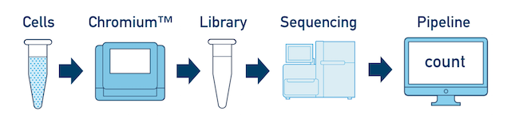
scRNA-Seq Downstream Analysis Workflow
?
Barcodes.tsv
Features.tsv
Matrix.mtx
Normalize & Scale
PCA & Nearest Neighbor Graph
Clustering
Advanced:
Cluster Marker Analysis
Cell Type Identification
Sub-clustering
Trajectories
Cell Cycle Analysis
Cluster DGE
Cells
Load Data
QC
Low Dimensional Embedding
https://bioinformatics.uconn.edu/single-cell-rna-sequencing-cell-ranger-2/

Slide 8
scRNA-Seq Downstream Analysis Workflow
?
Barcodes.tsv
Features.tsv
Matrix.mtx
Normalize & Scale
PCA & Nearest Neighbor Graph
Clustering
Advanced:
Cluster Marker Analysis
Cell Type Identification
Sub-clustering
Trajectories
Cell Cycle Analysis
Cluster DGE
Cells
Load Data
QC
Low Dimensional Embedding
https://bioinformatics.uconn.edu/single-cell-rna-sequencing-cell-ranger-2/

Slide 9
Wet lab prep for scRNA sequencing
https://dnacore.missouri.edu/10xgenomics.html

Slide 10
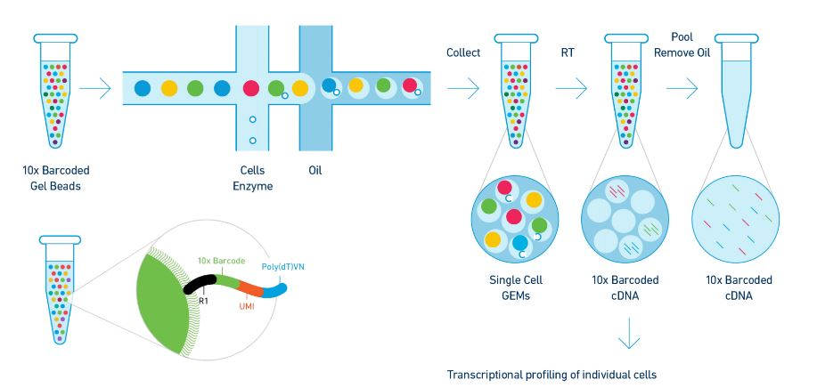
Wet lab prep for scRNA sequencing
https://dnacore.missouri.edu/10xgenomics.html

Slide 11
Wet lab prep for scRNA sequencing
https://dnacore.missouri.edu/10xgenomics.html

Slide 12
Wet lab prep for scRNA sequencing
https://dnacore.missouri.edu/10xgenomics.html

Slide 13
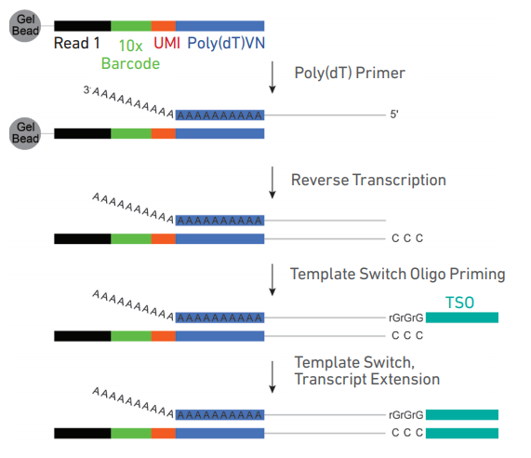
Wet lab prep for scRNA Sequencing
https://assets.ctfassets.net/an68im79xiti/1eX2FPdpeCgnCJtw4fj9Hx/7cb84edaa9eca04b607f9193162994de/CG000204_ChromiumNextGEMSingleCell3_v3.1_Rev_D.pdf

Slide 14
Wet lab prep for scRNA Sequencing
https://assets.ctfassets.net/an68im79xiti/1eX2FPdpeCgnCJtw4fj9Hx/7cb84edaa9eca04b607f9193162994de/CG000204_ChromiumNextGEMSingleCell3_v3.1_Rev_D.pdf

Slide 15
Wet lab prep for scRNA Sequencing
https://assets.ctfassets.net/an68im79xiti/1eX2FPdpeCgnCJtw4fj9Hx/7cb84edaa9eca04b607f9193162994de/CG000204_ChromiumNextGEMSingleCell3_v3.1_Rev_D.pdf

Slide 16
Wet lab prep for scRNA Sequencing
https://assets.ctfassets.net/an68im79xiti/1eX2FPdpeCgnCJtw4fj9Hx/7cb84edaa9eca04b607f9193162994de/CG000204_ChromiumNextGEMSingleCell3_v3.1_Rev_D.pdf

Slide 17
Wet lab prep for scRNA Sequencing
https://assets.ctfassets.net/an68im79xiti/1eX2FPdpeCgnCJtw4fj9Hx/7cb84edaa9eca04b607f9193162994de/CG000204_ChromiumNextGEMSingleCell3_v3.1_Rev_D.pdf

Slide 18
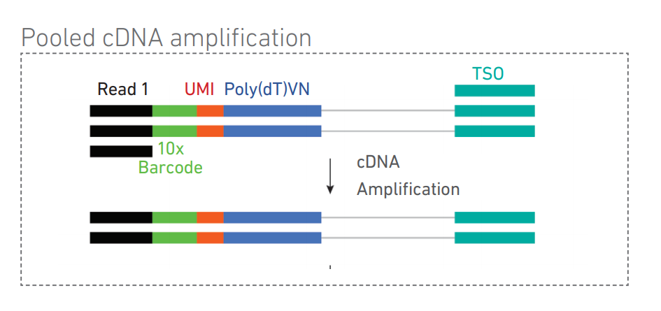
Wet lab prep for scRNA Sequencing
https://assets.ctfassets.net/an68im79xiti/1eX2FPdpeCgnCJtw4fj9Hx/7cb84edaa9eca04b607f9193162994de/CG000204_ChromiumNextGEMSingleCell3_v3.1_Rev_D.pdf

Slide 19
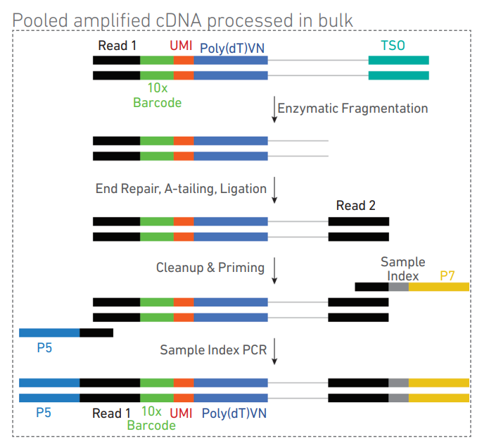
https://assets.ctfassets.net/an68im79xiti/1eX2FPdpeCgnCJtw4fj9Hx/7cb84edaa9eca04b607f9193162994de/CG000204_ChromiumNextGEMSingleCell3_v3.1_Rev_D.pdf

Slide 20
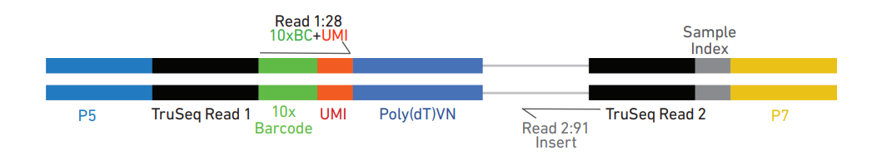
Wet lab prep for scRNA Sequencing
https://assets.ctfassets.net/an68im79xiti/1eX2FPdpeCgnCJtw4fj9Hx/7cb84edaa9eca04b607f9193162994de/CG000204_ChromiumNextGEMSingleCell3_v3.1_Rev_D.pdf

Slide 21
scRNA-Seq Downstream Analysis Workflow
?
Barcodes.tsv
Features.tsv
Matrix.mtx
Normalize & Scale
PCA & Nearest Neighbor Graph
Clustering
Advanced:
Cluster Marker Analysis
Cell Type Identification
Sub-clustering
Trajectories
Cell Cycle Analysis
Cluster DGE
Cells
Load Data
QC
Low Dimensional Embedding
https://bioinformatics.uconn.edu/single-cell-rna-sequencing-cell-ranger-2/

Slide 22
scRNA-Seq Downstream Analysis Workflow
?
Barcodes.tsv
Features.tsv
Matrix.mtx
Normalize & Scale
PCA & Nearest Neighbor Graph
Clustering
Advanced:
Cluster Marker Analysis
Cell Type Identification
Sub-clustering
Trajectories
Cell Cycle Analysis
Cluster DGE
Cells
Load Data
QC
Low Dimensional Embedding
https://bioinformatics.uconn.edu/single-cell-rna-sequencing-cell-ranger-2/

Slide 23
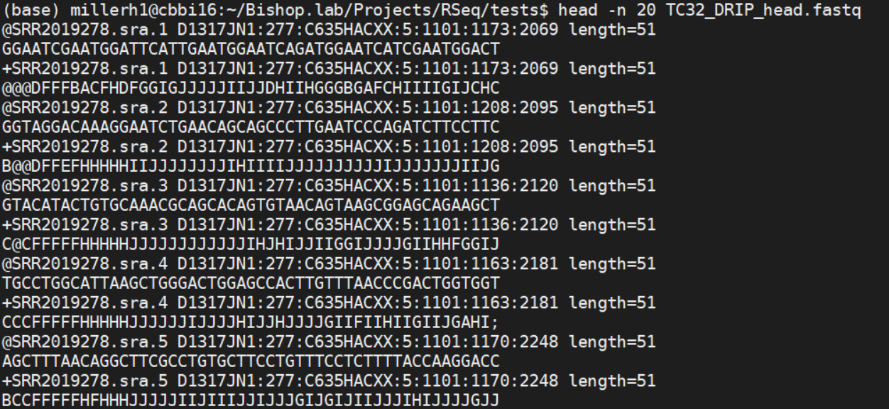
Read 1
Read 2
Read 3

Slide 24
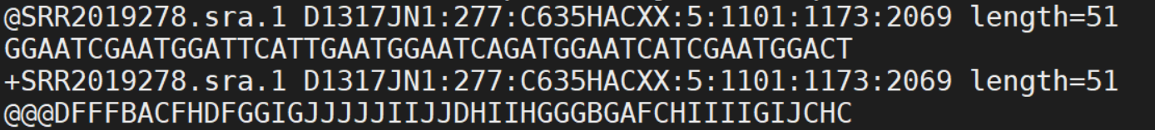
Read ID + sequencing info
GCAT sequence
Placeholder
Quality score of each base

Slide 25
Wet lab prep for scRNA Sequencing
https://assets.ctfassets.net/an68im79xiti/1eX2FPdpeCgnCJtw4fj9Hx/7cb84edaa9eca04b607f9193162994de/CG000204_ChromiumNextGEMSingleCell3_v3.1_Rev_D.pdf

Slide 26
Cell Ranger

Slide 27
Cell Ranger

Slide 28
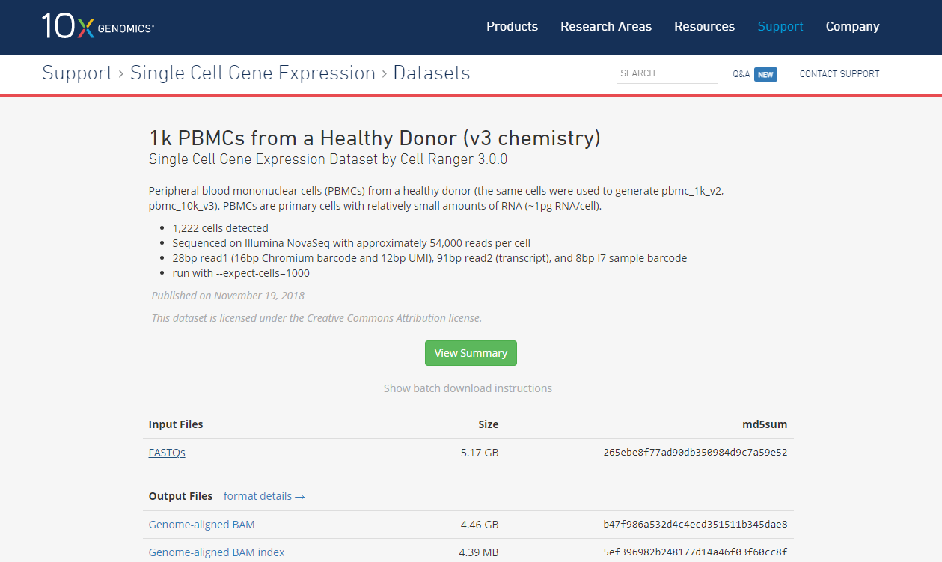

Slide 29
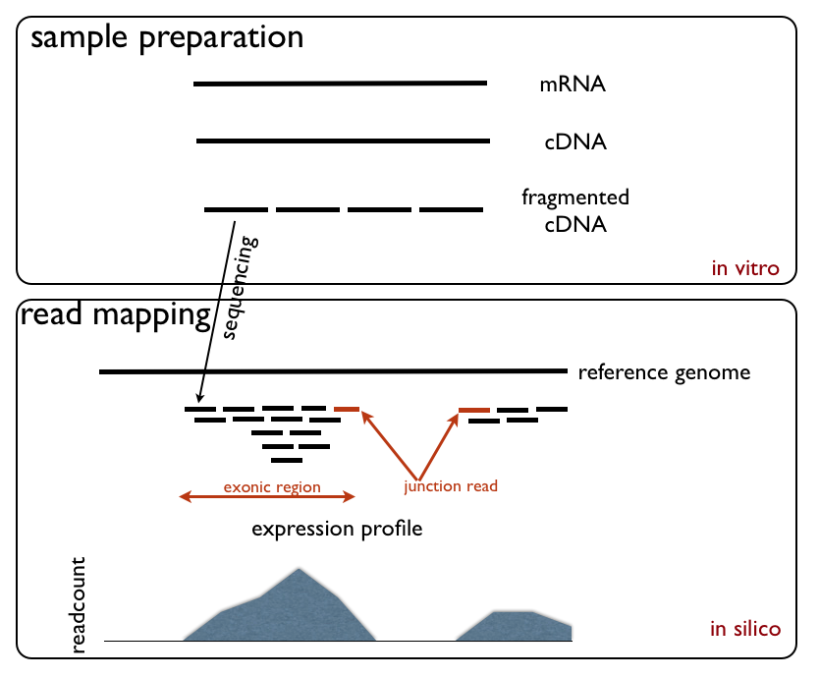
RNA-Sequencing steps
https://upload.wikimedia.org/wikipedia/commons/d/db/RNA_Seq_Experiment.png

Slide 30
scRNA-Seq Downstream Analysis Workflow
?
Barcodes.tsv
Features.tsv
Matrix.mtx
Normalize & Scale
PCA & Nearest Neighbor Graph
Clustering
Advanced:
Cluster Marker Analysis
Cell Type Identification
Sub-clustering
Trajectories
Cell Cycle Analysis
Cluster DGE
Cells
Load Data
QC
Low Dimensional Embedding
https://bioinformatics.uconn.edu/single-cell-rna-sequencing-cell-ranger-2/

Slide 31
scRNA-Seq Downstream Analysis Workflow
Load Data
QC
Normalize & Scale
PCA & Nearest Neighbor Graph
Clustering
Advanced:
Cluster Marker Analysis
Cell Type Identification
Sub-clustering
Trajectories
Cell Cycle Analysis
Cluster DGE
Low Dimensional Embedding

Slide 32
The sparsity challenge

Slide 33
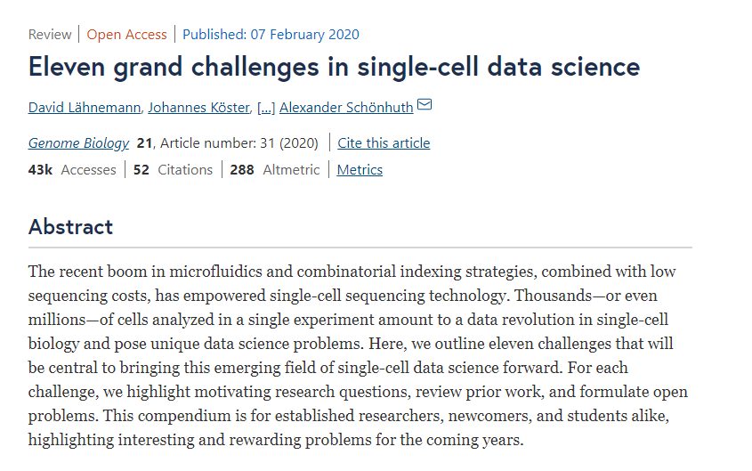

Slide 34
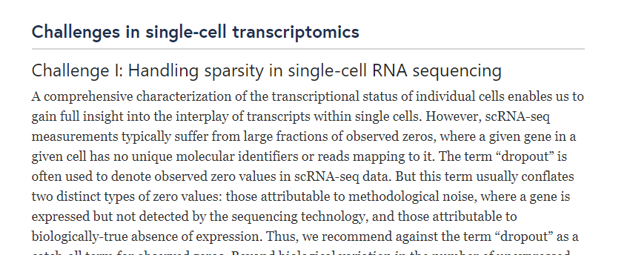

Slide 35
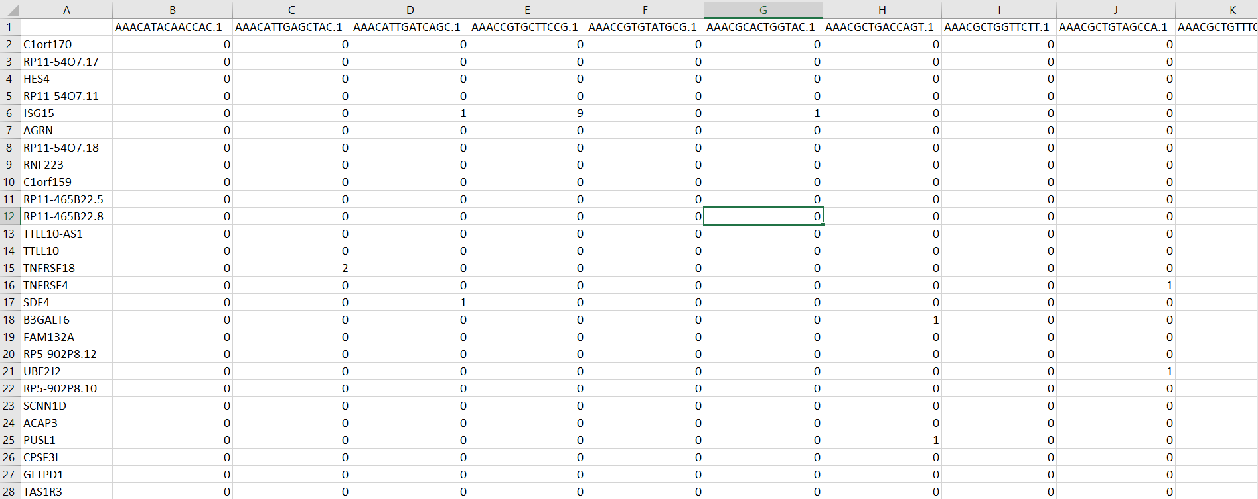
The Challenge of Sparsity

Slide 36
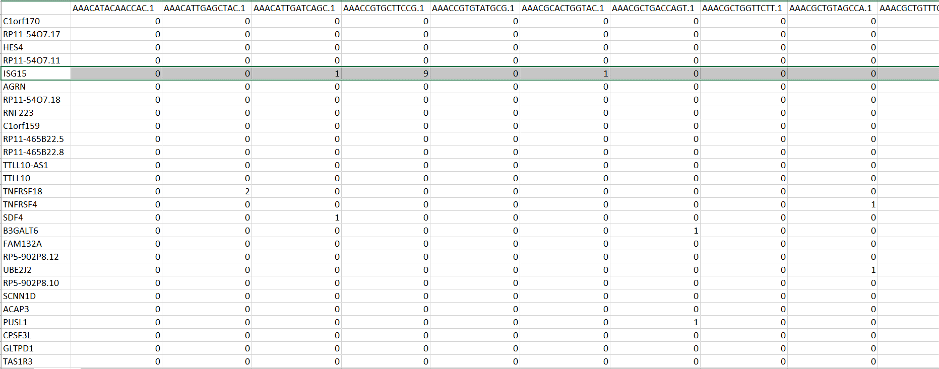
The Challenge of Sparsity

Slide 37
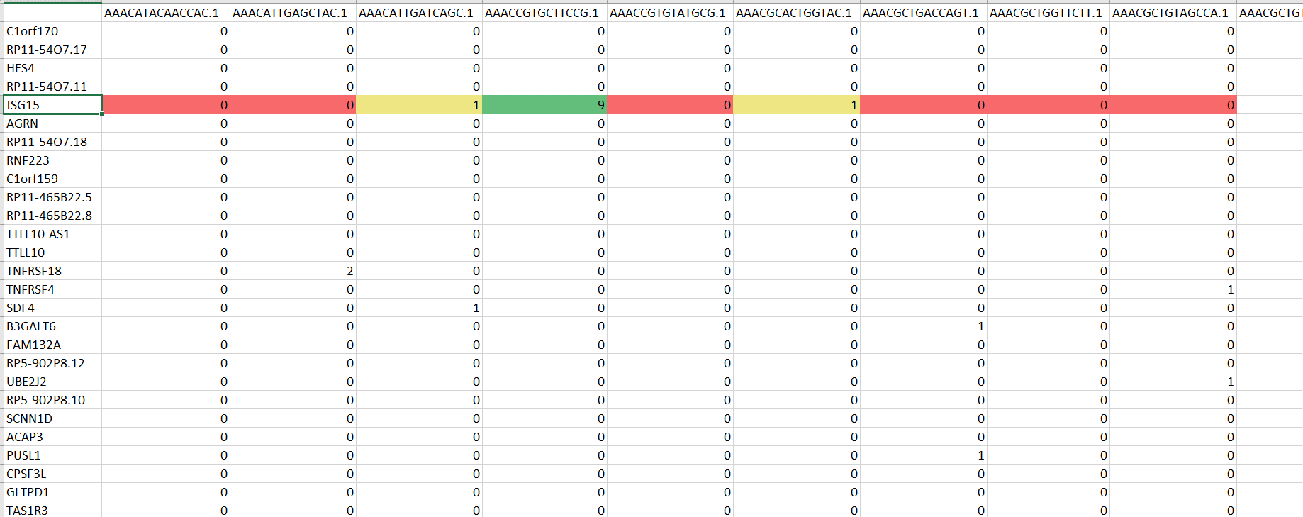
The Challenge of Sparsity

Slide 38
The Challenge of Sparsity
Uncertainty in sparse data:
How do you know if it is really 0?
How do you model this data when most of the values are 0?
How can you be sure about your analysis with so much statistical uncertainty?

Slide 39
The Challenge of Sparsity
Uncertainty in sparse data:
How do you know if it is really 0?
How do you model this data when most of the values are 0?
How can you be sure about your analysis with so much statistical uncertainty?

Slide 40
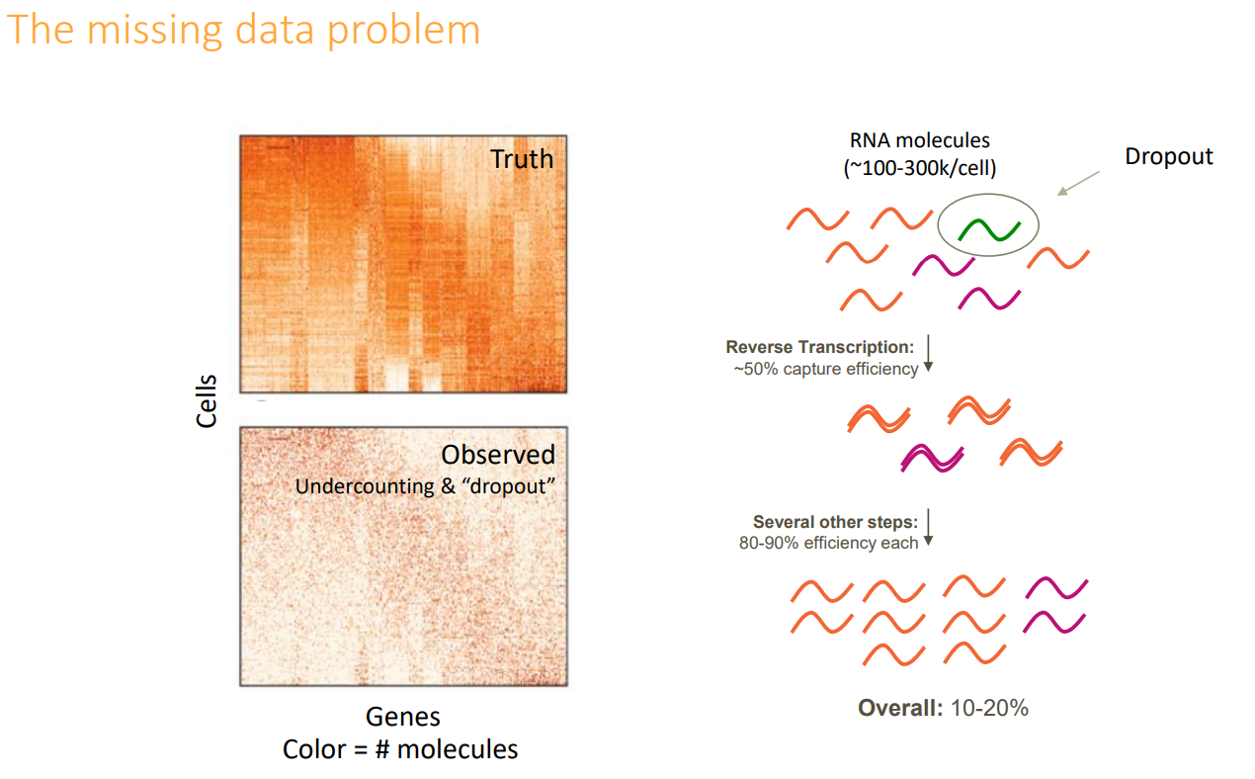
https://www.slideshare.net/insideHPC/singlecell-sequencing-for-drug-discovery-applications-and-challenges?from_action=save

Slide 41
https://www.slideshare.net/insideHPC/singlecell-sequencing-for-drug-discovery-applications-and-challenges?from_action=save

Slide 42
https://www.slideshare.net/insideHPC/singlecell-sequencing-for-drug-discovery-applications-and-challenges?from_action=save

Slide 43
https://www.slideshare.net/insideHPC/singlecell-sequencing-for-drug-discovery-applications-and-challenges?from_action=save

Slide 44
https://www.slideshare.net/insideHPC/singlecell-sequencing-for-drug-discovery-applications-and-challenges?from_action=save

Slide 45
How to handle Zero-Inflation?
Use a statistical framework which is robust against zero inflation
Impute missing UMI count values

Slide 46
How to handle Zero-Inflation?
Use a statistical framework which is robust against zero inflation
Impute missing UMI count values

Slide 47
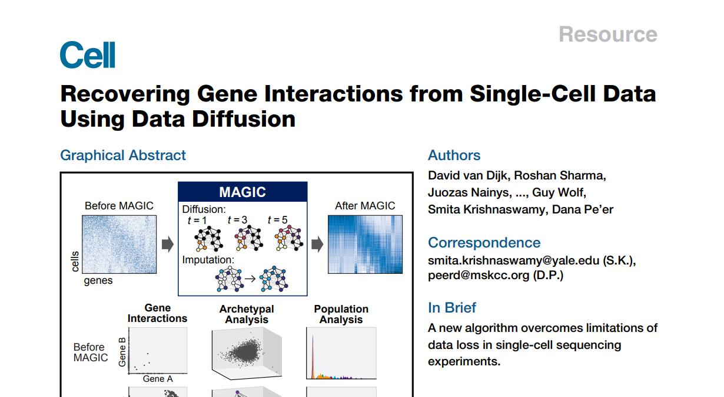

Slide 48
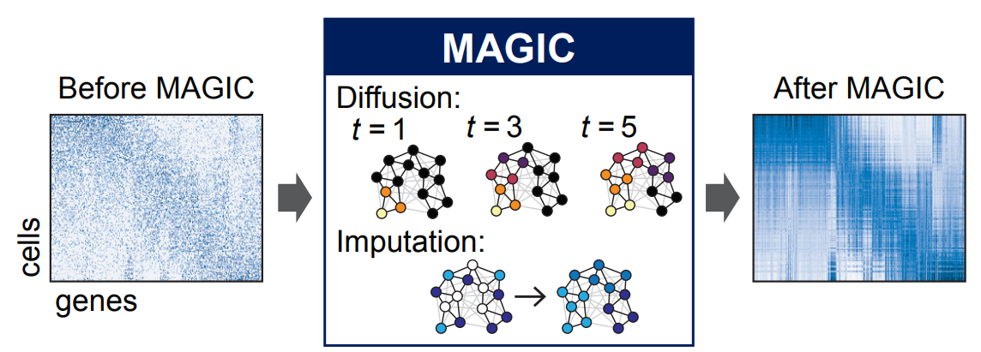
Imputation with MAGIC

Slide 49
scRNA-Seq Downstream Analysis Workflow
Load Data
QC
Normalize & Scale
PCA & Nearest Neighbor Graph
Clustering
Advanced:
Cluster Marker Analysis
Cell Type Identification
Sub-clustering
Trajectories
Cell Cycle Analysis
Cluster DGE
Low Dimensional Embedding

Slide 50
scRNA-Seq Downstream Analysis Workflow
Load Data
QC
Normalize & Scale
PCA & Nearest Neighbor Graph
Clustering
Advanced:
Cluster Marker Analysis
Cell Type Identification
Sub-clustering
Trajectories
Cell Cycle Analysis
Cluster DGE
Low Dimensional Embedding

